Slide 1
Control of an Electrically Powered Two-Spool Turbine Device Advanced Courses in Engineering 19 Jan 2017 rev. 1
Former Instructors:
Dave Gutz (rev 2017-1)
PICTURE

Slide 2
Outline
Description of Project
Wind Turbine Primer
Modeling and Linearization
Lab

Slide 3
Description of Project

Slide 4
Regulator: Subsystem or independent device that determines and maintains the operating parameters of a system, usually within certain prescribed or preset limits. Read more: http://www.businessdictionary.com/definition/regulator.html
Open-loop control can be used in systems sufficiently well-characterized as to predict what outputs will necessarily achieve the desired states. For example, the rotational velocity of an electric motor may be well enough characterized for the supplied voltage to make feedback unnecessary.
The drawback of open-loop control is that it requires perfect knowledge of the system (i.e. one knows exactly what inputs to give in order to get the desired output), and it assumes there are no disturbances to the system.
In control theory, a controller is a device, historically using mechanical, hydraulic, pneumatic or electronic techniques often in combination, but more recently in the form of a microprocessor or computer, which monitors and physically alters the operating conditions of a given dynamical system.^{[1]} ^{[2]}Typical applications of controllers are to hold settings for temperature, pressure, flow or speed.

Slide 5
Wind Turbine Primer

Slide 6
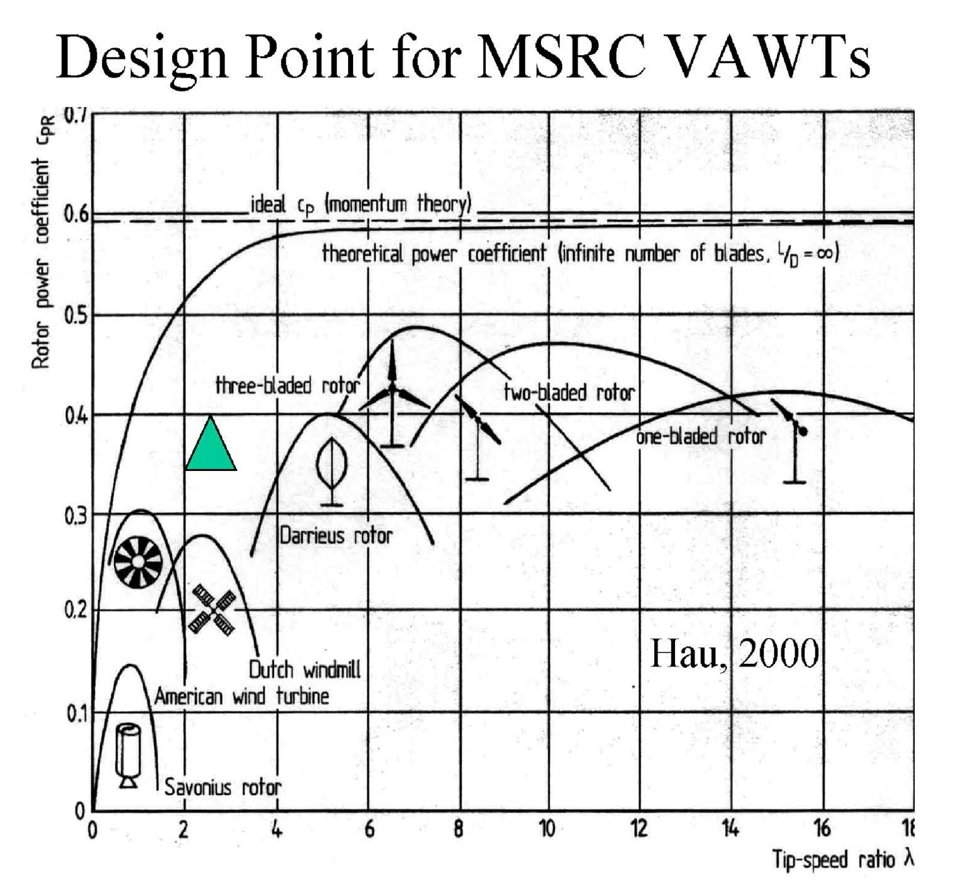
Wind Turbine Overview

Slide 7
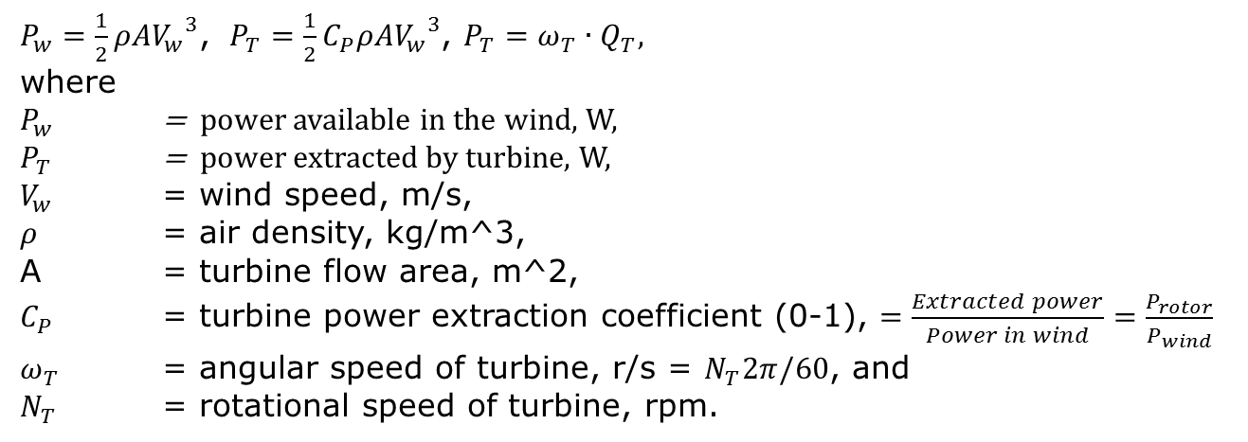
Wind Turbine Primer
$P_{w}=\frac{1}{2}ρA{V_{w}^{}}_{}^{3}$, $P_{T}=\frac{1}{2}C_{P}ρA{V_{w}^{}}_{}^{3}$, $P_{T}=ω_{T}∙Q_{T},$
where
$P_{w}$ = power available in the wind, W,
$P_{T}$ = power extracted by turbine, W,
$V_{w}$ = wind speed, m/s,
$ρ$ = air density, kg/m^3,
A = turbine flow area, m^2,
$C_{P}$ = turbine power extraction coefficient (0-1), $=\frac{Extracted power}{Power in wind}=\frac{P_{rotor}}{P_{wind}}$
$ω_{T}$ = angular speed of turbine, r/s = $N_{T}2π/60$, and
$N_{T}$ = rotational speed of turbine, rpm.
Define another useful relationship: $λ=Tip Speed Ration=TSR= \frac{ω_{rotor}∙R_{rotor}}{V_{wind}}$
http://www.nrel.gov/docs/fy12osti/52780.pdf
Santoso,S. and Singh, M. “Dynamic Models for Wind Turbines and Wind Power Plants,” National Renewable Energy Laboratory Publication, UT Austin, Austin, Texas, NREL/SR-5500-52780 October, 2011.
https://en.wikipedia.org/wiki/Variable_speed_wind_turbine

Slide 8
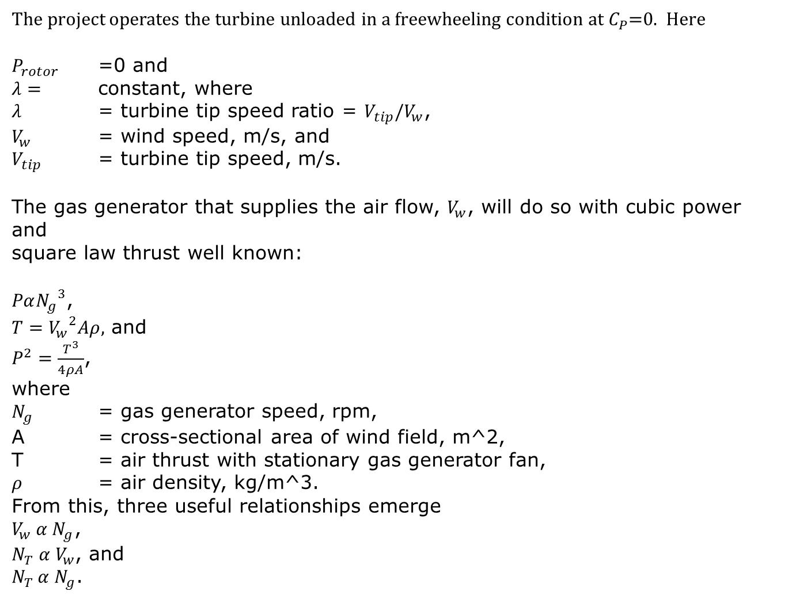
Speed-Speed Relationship
The project operates the turbine unloaded in a freewheeling condition at $C_{P}$=0. Here
$P_{rotor}$ =0 and
$λ=$ constant, where
$λ$ = turbine tip speed ratio = $V_{tip}/V_{w}$,
$V_{w}$ = wind speed, m/s, and
$V_{tip}$ = turbine tip speed, m/s.
The gas generator that supplies the air flow, $V_{w}$, will do so with cubic power and
square law thrust well known:
$Pα{N_{g}}^{3}$,
$T={V_{w}}^{2}Aρ,$ and
$P^{2}=\frac{T^{3}}{4ρA}$,
where
$N_{g}$ = gas generator speed, rpm,
A = cross-sectional area of wind field, m^2,
T = air thrust with stationary gas generator fan,
$ρ$ = air density, kg/m^3.
From this, three useful relationships emerge
$V_{w} α N_{g}$,
$N_{T} α V_{w}$, and
$N_{T }α N_{g}$.
The turbine behaves like a screw in incompressible flow.

Slide 9
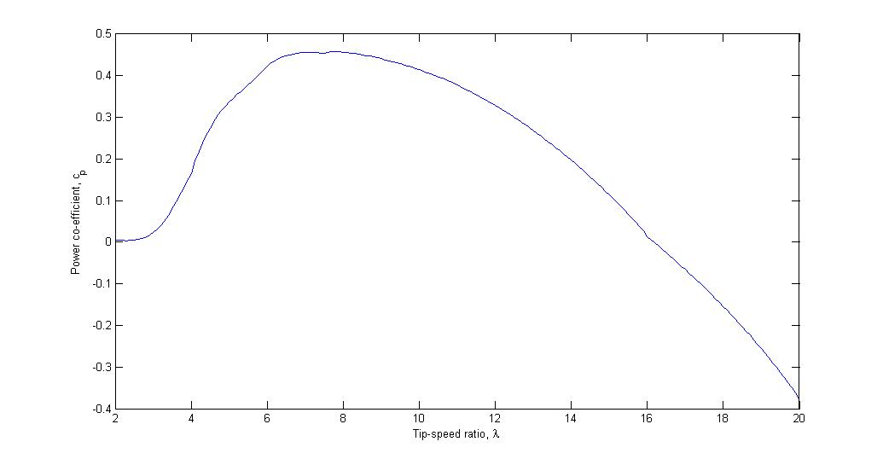
Power Coefficient Characterized by Tip Speed Ratio
Slope is related to damping torque ( N )
https://en.wikipedia.org/wiki/Variable_speed_wind_turbine

Slide 10
Get content from my white book
Get Cp curves from my personal OneNote
Assumption: neglect laminar flow Re effects

Slide 11
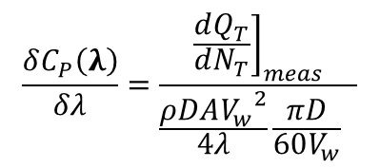


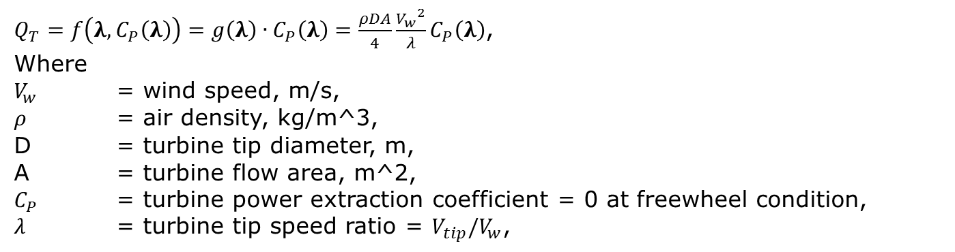
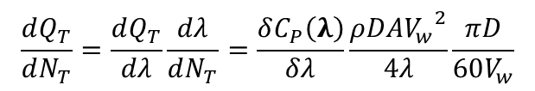

Deriving Damping from Measured Time Constant
$Q_{T}=f\left(λ, C_{P}\left(λ\right)\right)=g\left(λ\right)∙C_{P}\left(λ\right)=\frac{ρDA}{4}\frac{{V_{w}}^{2}}{λ}C_{P}\left(λ\right)$,
Where
$V_{w}$ = wind speed, m/s,
$ρ$ = air density, kg/m^3,
D = turbine tip diameter, m,
A = turbine flow area, m^2,
$C_{P}$ = turbine power extraction coefficient = 0 at freewheel condition,
$λ$ = turbine tip speed ratio = $V_{tip}/V_{w}$,
$$\frac{dQ_{T}}{dN_{T}}=\frac{dQ_{T}}{dλ}\frac{dλ}{dN_{T}}=\frac{δC_{P}\left(λ\right)}{δλ}\frac{ρDA{V_{w}}^{2}}{4λ}\frac{πD}{60V_{w}}$$
$\frac{dQ_{T}}{dλ}=\frac{δg}{δλ}C_{P}\left(λ\right)+\frac{δC_{P}\left(λ\right)}{δλ}g\left(λ\right)$, chain rule
$$\frac{δλ}{δN_{T}}=\frac{πD}{60V_{w}}$$
$$\frac{δg}{δλ}=−\frac{ρDA}{4}\frac{{V_{w}}^{2}}{λ^{2}}$$
$\frac{δC_{P}\left(λ\right)}{δλ}=\text{TBD} \text{from} \text{test}$ measurement for time constant.
$$\frac{δC_{P}\left(λ\right)}{δλ}=\frac{{\left.\frac{dQ_{T}}{dN_{T}}\right]}_{meas}}{\frac{ρDA{V_{w}}^{2}}{4λ}\frac{πD}{60V_{w}} }$$

Slide 12
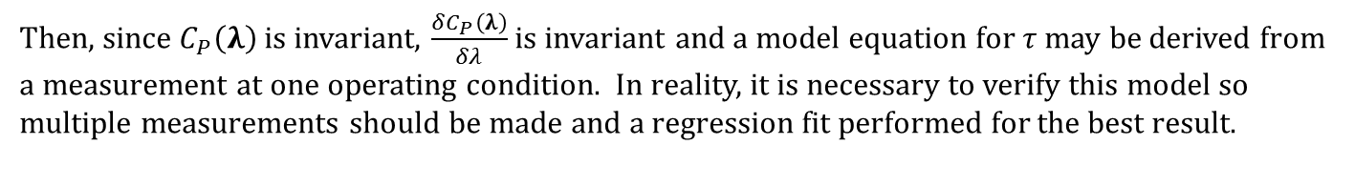
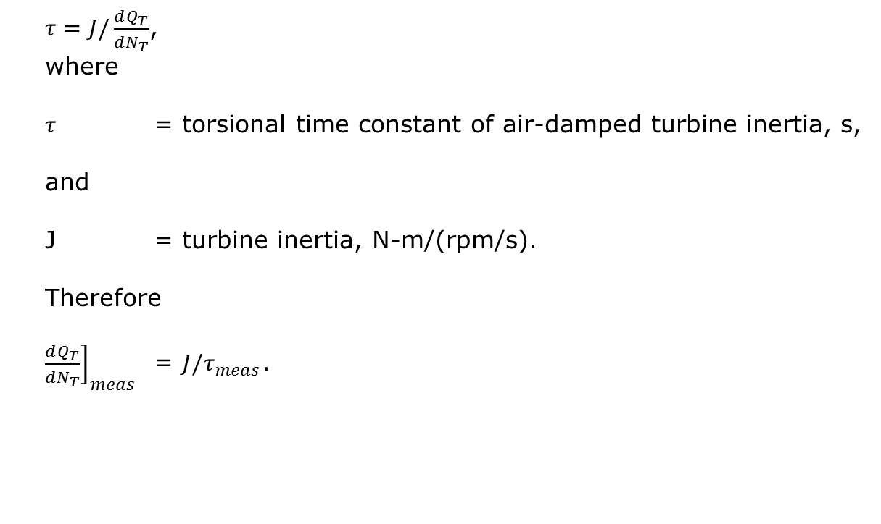
Measuring Damping to Calibrate the Model
$τ=J/\frac{dQ_{T}}{dN_{T}}$,
where
$τ$ = torsional time constant of air-damped turbine inertia, s,
and
J = turbine inertia, N-m/(rpm/s).
Therefore
${\left.\frac{dQ_{T}}{dN_{T}}\right]}_{meas}$ = $J/τ_{meas}$.
Then, since $C_{P}\left(λ\right)$ is invariant, $\frac{δC_{P}\left(λ\right)}{δλ}$ is invariant and a model equation for $τ$ may be derived from a measurement at one operating condition. In reality, it is necessary to verify this model so multiple measurements should be made and a regression fit performed for the best result.

Slide 13
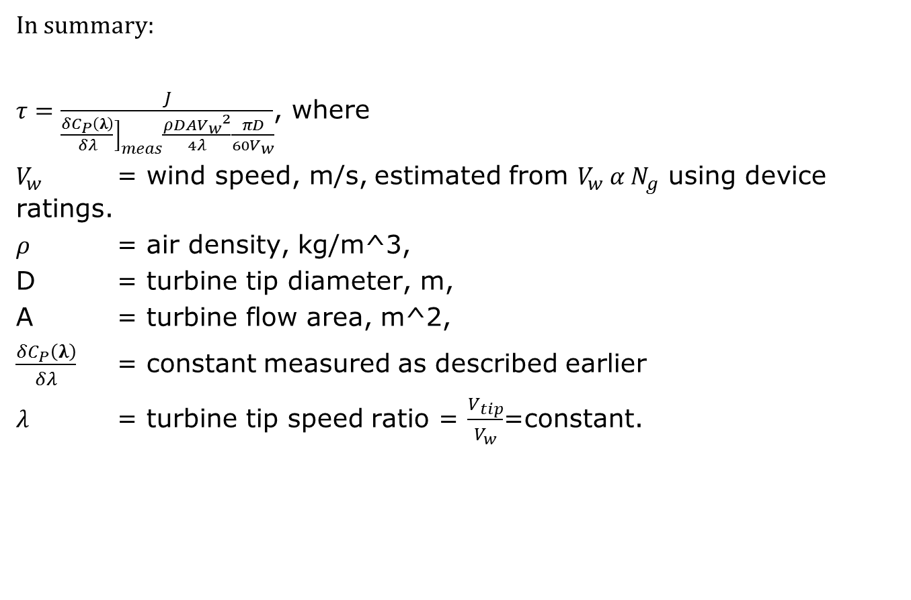
Summary of Turbine Dynamic Model
In summary:
$τ=\frac{J}{{\left.\frac{δC_{P}\left(λ\right)}{δλ}\right]}_{meas}\frac{ρDA{V_{w}}^{2}}{4λ}\frac{πD}{60V_{w}}}$, where
$V_{w}$ = wind speed, m/s, estimated from $V_{w} α N_{g}$ using device ratings.
$ρ$ = air density, kg/m^3,
D = turbine tip diameter, m,
A = turbine flow area, m^2,
$\frac{δC_{P}\left(λ\right)}{δλ}$ = constant measured as described earlier
$λ$ = turbine tip speed ratio = $\frac{V_{tip}}{V_{w}}$=constant.

Slide 14
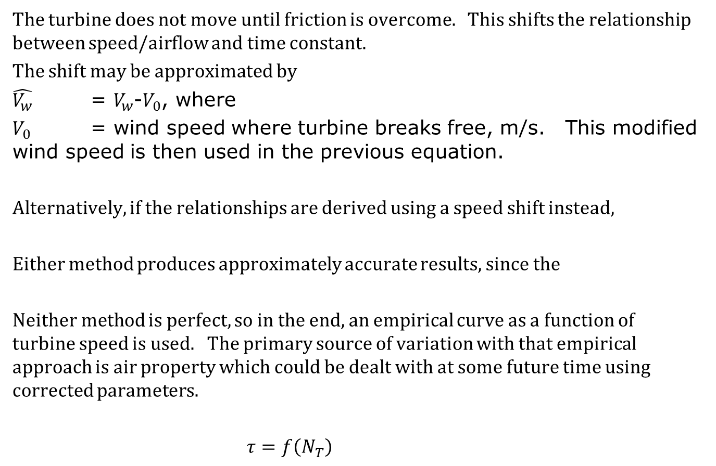
Practical Implementation of Turbine Dynamic Model
The turbine does not move until friction is overcome. This shifts the relationship between speed/airflow and time constant.
The shift may be approximated by
$\hat{V_{w}}$ = $V_{w}$-$V_{0}$, where
$V_{0}$ = wind speed where turbine breaks free, m/s. This modified wind speed is then used in the previous equation.
Alternatively, if the relationships are derived using a speed shift instead,
Either method produces approximately accurate results, since the
Neither method is perfect, so in the end, an empirical curve as a function of turbine speed is used. The primary source of variation with that empirical approach is air property which could be dealt with at some future time using corrected parameters.
$τ=f\left(N_{T}\right)$

Slide 15
ESC – Electronic Speed Control of Brushless DC Motor (BLDC)

Slide 16
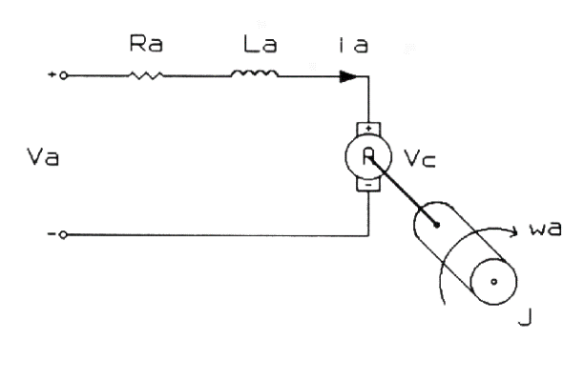
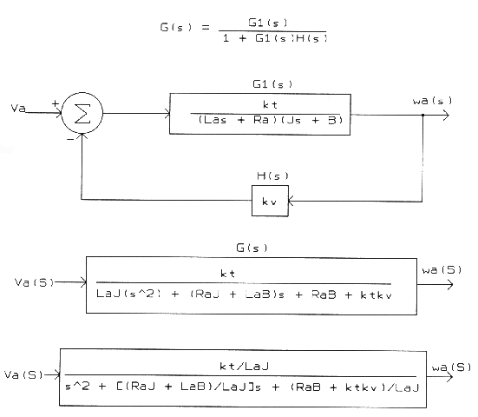
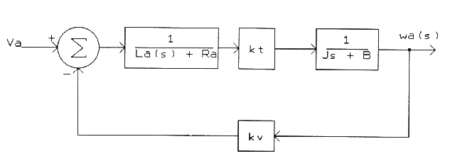
DC Motor Dynamic Model
http://www.profjrwhite.com/system_dynamics/sdyn/s6/s6fmathm/s6fmathm.html
Bandwidth > 30 Hz

Slide 17
Modeling

Slide 18
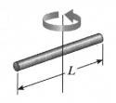
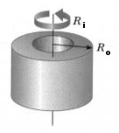
Moment of Inertia of Propeller

Slide 19
Motor Constants – SI Units Assumptions
The main thing I want you to take away from this post is that when a motor rotates it generates a back-emf. That back-emf is proportional to the motor speed and the Kv constant tells you how they relate to each othe

Slide 20
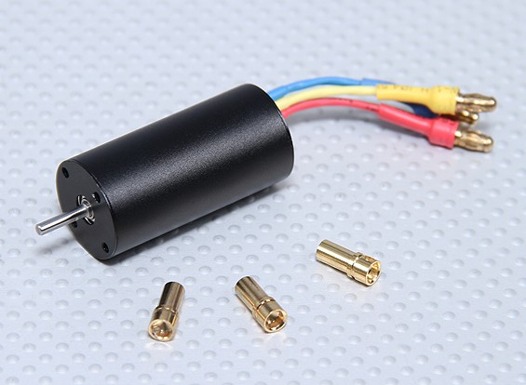
2040 Brushless Inrunner Motor 4800kv

Slide 21
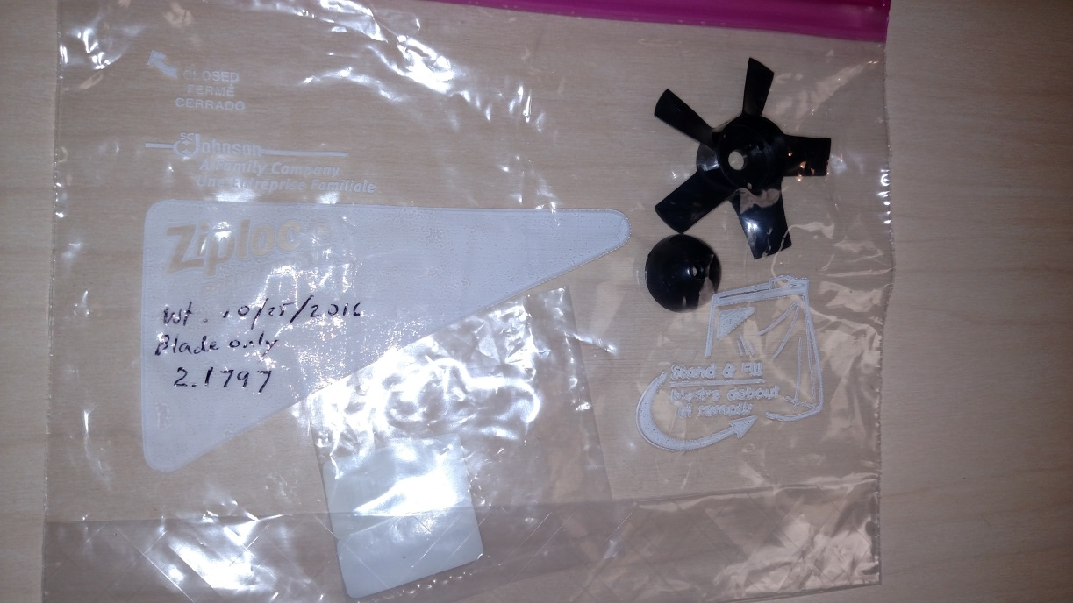

Slide 22
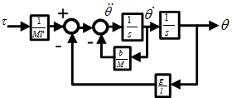
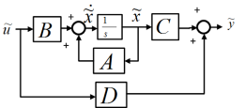
Landscape of Control System Analysis
DATA Verify
Physical System
Non-Linear Ordinary Differential Equations
Non-linearities
Modeline
Toolboxes
SISO
Matlab Tools
MIMO
Linear Analysis
Linear Differential Equations
Block Diagram
State-Space
Z-Transform
Linear
System
Beacon
Simulink-Maplesim-Labview
Shortcut
Simulink “Linearize”
Matlab
Academia
SCADE
Control
Models
Embedded
Logic
Verify
Margin
Analysis
Theory

Slide 23
Linearization Example – deep dive
Drop the “delta” symbols to an implied “delta model”
And apply the initial conditions at the known stability points:

Slide 24
Linearization Example
Consider a simple pendulum with applied torque τ :
Physical System
τ
θ
l
b
M
⇒
The equation of motion is:
Nonlinear Differential Equations
The Linear Differential Equations at two natural stability points are:
⇒
Linear Differential Equations
Notes:
You know by inspection that the system has two equilibrium points: $θ=0$and $θ=π$
The one at 0 is stable. The one at the top is unstable. The linearization process should reveal this.

Slide 25
Exercise #1
Open Matlab R2013A or later
Enter the following at the command line:
g = 32.2; % Gravity, ft/sec^2
l = g*(1/(2*pi))^2; % Pendulum length for 1 sec period, ft
b = 0.01; % Damping, lbf/(ft/sec)
d = 1; % Diameter steel pendulum sphere, in
M = 4/3*pi*(d/2)^3*.3/g; % Mass of ball, slugs
Tpulse = 1; % Pulse time, sec
Hpulse = 10; % Pulse height, ft-lbf
Dpulse = 0.1; % Pulse duration, sec
Open a new Simulink diagram. Save it as “myPendulum.slx”
Open “ClassroomLibrary.” If no icons appear, then make sure the “SimulinkLibrary” folder is present and try again.
Draw the system using the blocks available in the Library
Connect the Impulse source and scope to the system. Run it. Save it. Is the observed natural period 1 second?

Slide 26
Transfer Functions

Slide 27
Progress – Model to Linear D.E.
Physical System
⇒
Nonlinear Differential Equations
⇒
Linear Differential Equations
⇒
Transfer Function
l
θ
M
Notes:
The goal is Transfer Functions

Slide 28
An Aside: State Space
Recall Taylor Series Expansion of Partial Differential Equation
It is common to separate internal and external influences. This allows Eigenvalue analysis (states) separate from Boundary Value solutions.
Abbreviate
Notes:
State Space is extremely useful as a bridge between different kinds of analysis tools.

Slide 29
State Space Continued
Accompanying any dynamical system will be a set of O.D.E.s describing the equations of motion:
Further generalize the internal states, x. Note that ANY state has a value and a derivative. The second derivative is the derivative of the state representing the first derivative, and so on:

Slide 30
State Space Continued
Now a general single-input, single-output (SISO) dynamical system will have a system of equations as it’s general representation.
Define some small letters to clean up the nomenclature:

Slide 31
State Space Concluded
In general, all the parameters are vectors or arrays with all sorts of real-world cross-coupling and will be multi-input, multi-output (MIMO).

Slide 32
This “State” Concept Can Be Leveraged to Create a Nice Block Diagram Connection. If this all seems a mish-mash it is. These are different symbols for representing the same concept. In fact, a Bode plot is another symbol.

Slide 33

How it All Connects – these are all mathematically equivalent
ODE
Complex derivations
Math ‘engine’
Physically intuitive
MIMO shorthand
GUI Application
MIMO shorthand
GUI Application
Control Intuitive (Bode bridge)
DSP connection by Fourier

Slide 34
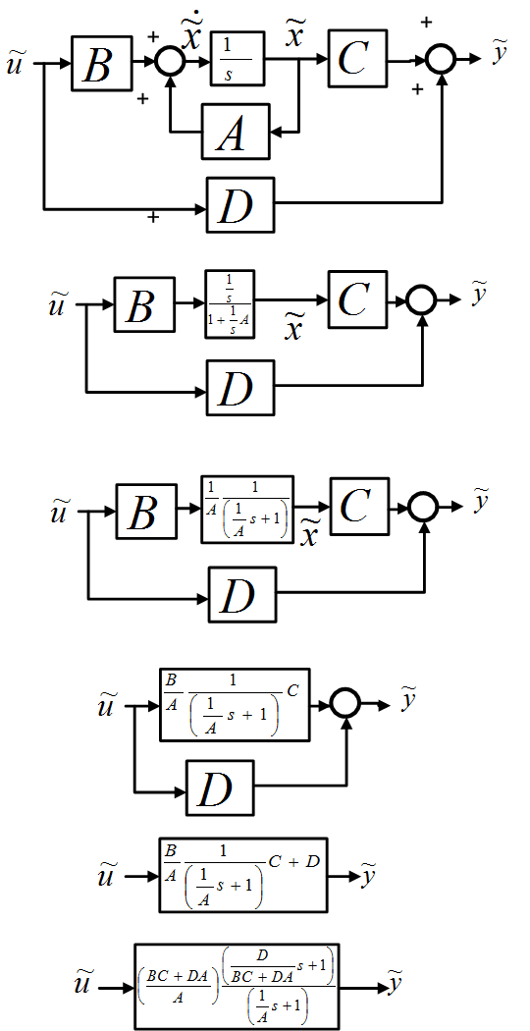
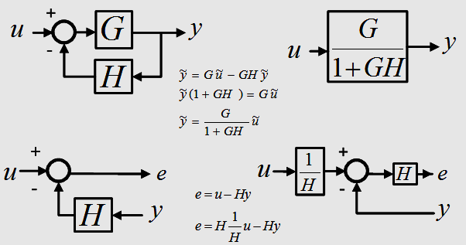
Example: Derivation of Transfer Function from Block Diagram
These are all the clues you need to know.
Block diagrams are drawings of algebraic equations.

Slide 35
Example Cont’d - Transfer Function
Consider a simple pendulum with applied torque τ :
τ
θ
l
b
Physical System
M
⇒
The equation of motion is:
Nonlinear Differential Equations
⇒
Linearize and apply at the bottom dead-center:
Linear Differential Equations
⇒
A transfer function can now be derived:
Transfer Function

Slide 36
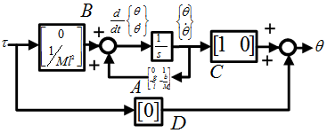
Conclusion – Model to LTI
Physical System
⇒
Nonlinear Differential Equations
⇒
Linear Differential Equations
⇒
Transfer Function
τ
θ
l
b
M
⇒
⇒
Block Diagram
⇒
State-Space
Control Design
Notes:
More on this later. Draw in Simulink now?

Slide 37
In-Class Exercise:
Draw pendulum in Simulink
Generate time response; verify period of oscillation
Repeat in Matlab using SS. Use CL and functions to verify Simulink result
Repeat in Matlab using LTI.....Verify Eigenvalues. Make LTI steps and Bodes

Slide 38
Frequency Response

Slide 39
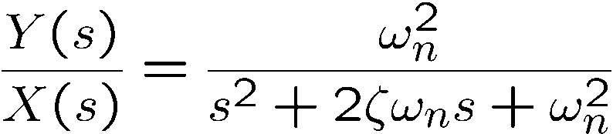
Types of Responses
Consider a typical second order system:
where ω_{n} = 10 and ζ = 0.3
The following responses are presented on the next slide:
Unforced response (with initial condition)
Impulse response
Step response
Sinusoidal response
From now on we're going to concentrate on the sinusoidal or “frequency response.”

Slide 40

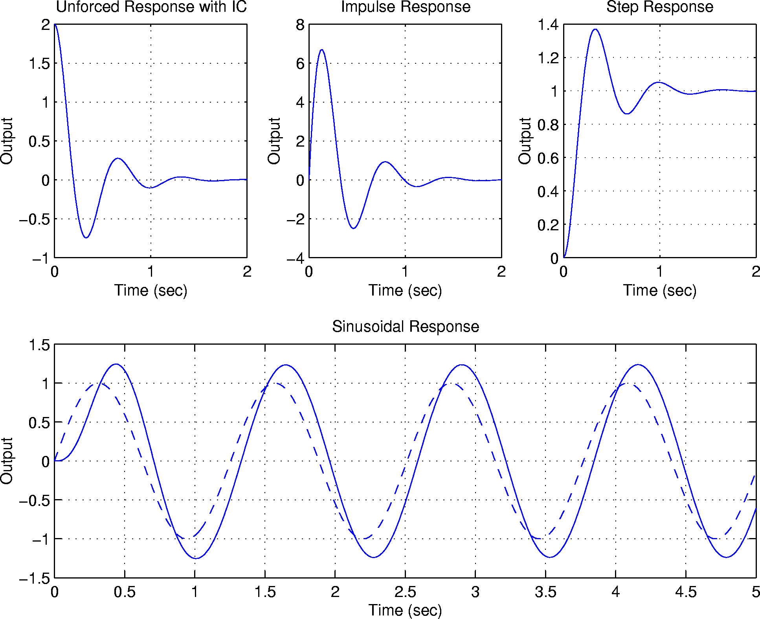
Do all these examples in Simulink during class. Figure out a streamlined way to do it, e.g. interactive script that pages through

Slide 41


The Frequency Response
What is it?
If a stable linear time invariant system is driven with a steady sinusoidal input, the output will be another sinusoid of the same frequency but with a different amplitude and phase shift.
The frequency response of the system relates the output sinusoid
amplitude and phase shift to that of the input:
H (LTI Sys)
In dynamic systems both the ratio B/A and the phase angle φ are functions of the frequency ω .

Slide 42
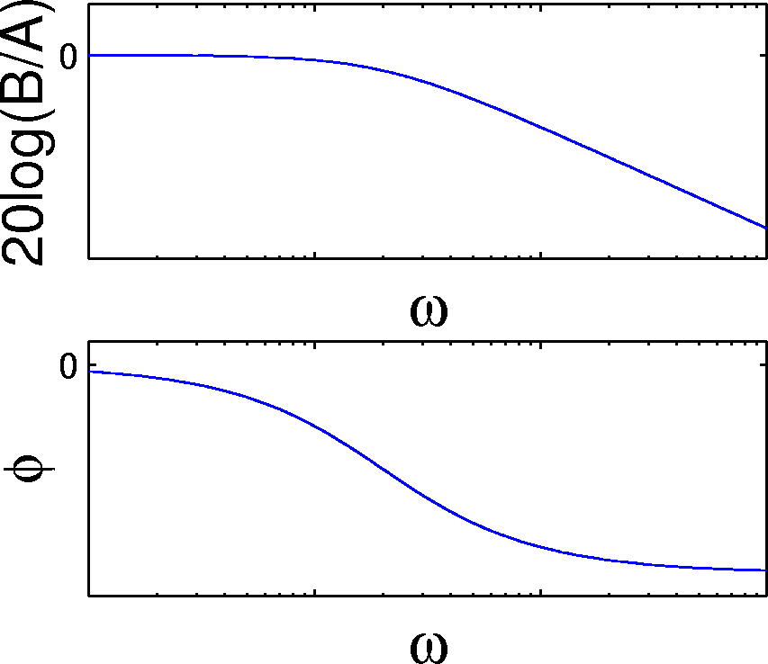
What is Frequency Response (continued)
A Bode plot shows the complete picture of B/A and φ :
Note that the frequency axis is a log scale, and the magnitude is measured in decibels. This allow the response to be estimated as a series of straight lines. Also note the shape:
Amplitude ratio rolls off as frequency increases
Phase angle is negative
This is typical of physical systems
They are often low pass—high frequencies are attenuated
They exhibit phase loss or phase lag

Slide 43
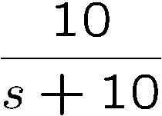
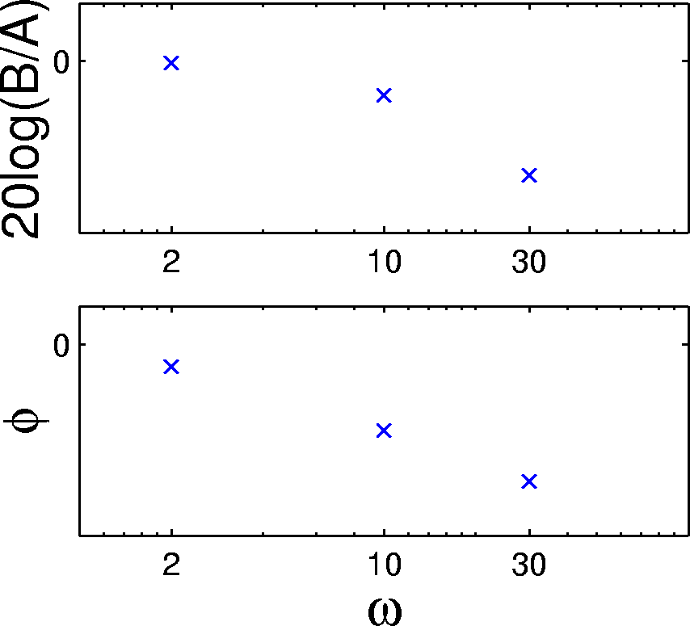
What is Frequency Response (continued)
Let’s look at some sinusoidal responses of
Note that as frequency gets large the output cannot keep up:
Do all these examples in Simulink during class. Figure out a streamlined way to do it, e.g. interactive script that pages through

Slide 44
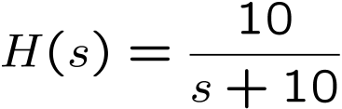
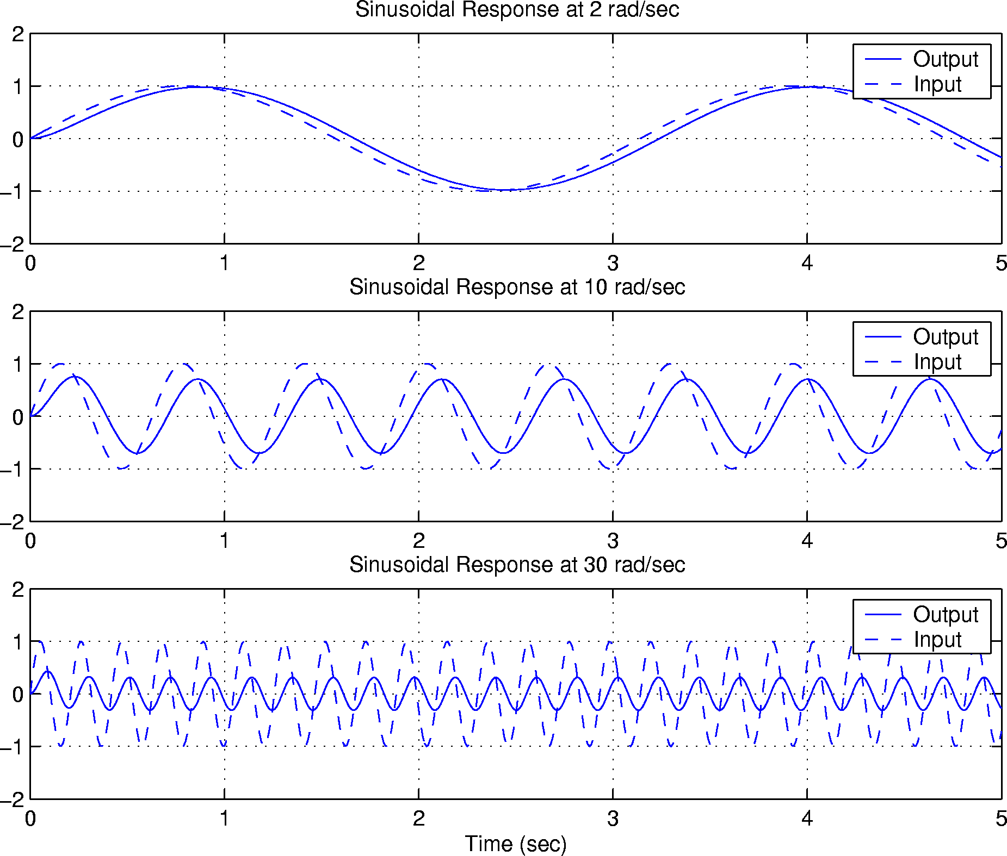
Do all these examples in Simulink during class. Figure out a streamlined way to do it, e.g. interactive script that pages through

Slide 45
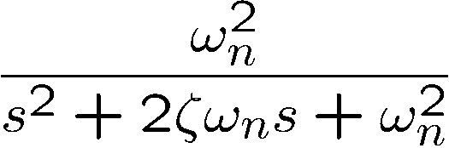
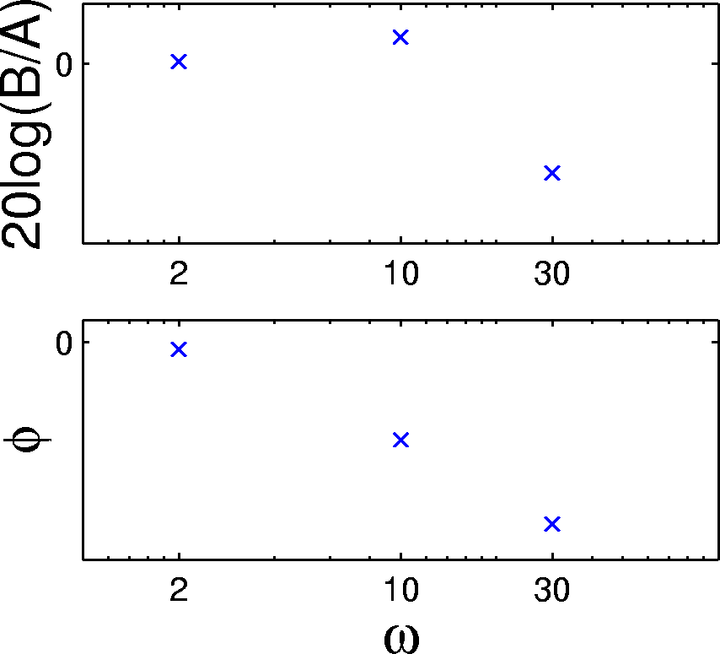
What is Frequency Response (continued)
Resonant systems have a frequency range where the output is amplified
Consider sinusoidal responses shown on the next page for
where ω_{n} = 10 and ζ = 0.3
Note the amplification at ω = 10 which is at the natural frequency of the system:

Slide 46
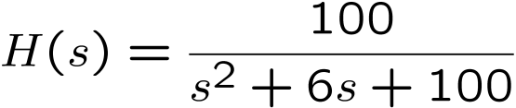
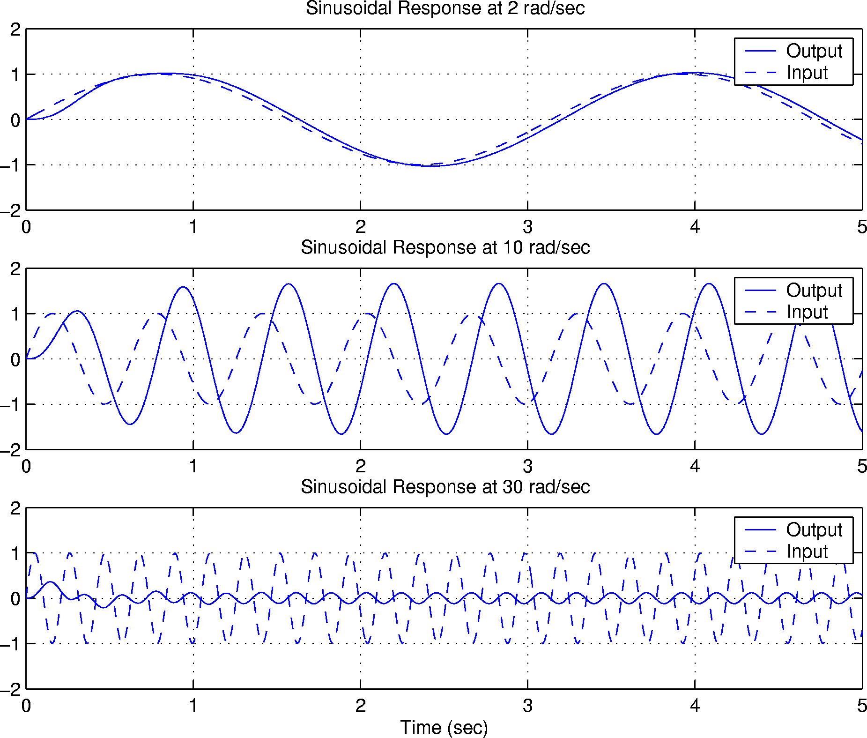
Do all these examples in Simulink during class. Figure out a streamlined way to do it, e.g. interactive script that pages through

Slide 47
Backup

